Slide 1

Getting started with MonoGame using Visual Studio 2015
Darkside of Monogame
Simon Jackson
Author and Microsoft MVP
@SimonDarksidej

Slide 2

News headlines
As of March 2017, we have two major events
MonoGame 3.6 was released
Visual Studio 2017 was released

Slide 3
Getting Started – Visual Studio 2015
Session will cover what is needed for:
Developing games for Windows desktop / Linux / OpenGL
Building Content Pipeline Projects
Developing Game for Android
Developing Games for iOS / MacOS
Developing Games for Windows 8.1/WM8.1
Developing Games for Windows 10 UWP

Slide 4
Default Visual Studio 2015 C# install
Out of the box, you can build the following project types:
Windows Desktop DX (classic)
Cross-Platform OpenGL (Linux / Windows / Etc)
Content Pipeline Extensions
Gets you a basic game up and running or several platforms
Be sure to check the video below for best-practices in setting up a multi-platform MonoGame Project:
http://bit.ly/monogamemulti-platform

Slide 5
Building for Android
What’s required for android development

Slide 6
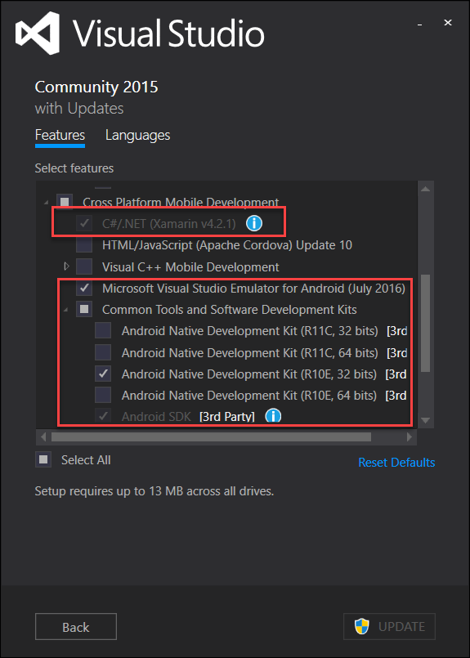
Android setup for Visual Studio 2015
Requires the Xamarin Core module (C#/.NET Xamarin)
Requires Android SDK for target builds
Requires Android NDK (native dev kit) for target builds
Optional – Visual Studio Android emulator
Optional – Xamarin account (recommended)

Slide 7
Tips ‘n’ tricks with Android
Be aware it’s a fragmented platform – likely need several projects
Use MS Android emulator over Google Android Emulator (unless you like pain)
MS Emulator requires a minimum machine with 8GB memory Alternatively use connected device
Physically testing is critical due to device differences, plan ahead Use Xamarin cloud test or the recently announced Azure Mobile test platform (Xamarin cloud Mk2) at: http://mobile.azure.com (currently in preview)
Get a Xamarin account, it’s free and gives you update news

Slide 8
Building for iOS / MacOS
What’s required for Apple development

Slide 9
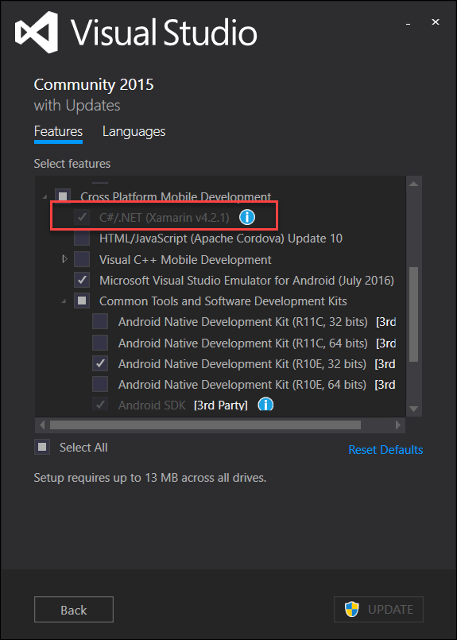
iOS setup for Visual Studio 2015
Only requires the Xamarin Core module (C#/.NET Xamarin)
Optional – Xamarin account (recommended)
Requires a MAC build host machine!

Slide 10
Tips ‘n’ tricks with iOS / MacOS
Cannot build for MAC on Windows. Can only be done on a MAC ☹
iOS builds require a MAC to build on, can develop on Windows
Physically testing is recommended, plan ahead Use Xamarin cloud test or the recently announced Azure Mobile test platform (Xamarin cloud Mk2) at: http://mobile.azure.com (currently in preview)
Get a Xamarin account, it’s free and gives you update news

Slide 11
Sorting out your Mac Build Host
You need a MAC ☺ but can be done with a cheap Mac Mini if you don’t have one (But check the following requirements before buying)
Requires:
The latest iOS SDK.
The latest version of Xcode.
Mac OS X Yosemite(10.10) & above.
Apple Dev Center account
Xamarin Software is FREE now, even on Mac
Extended capabilities will require either a Xamarin License or MSDN subscription
See the following site for more details https://developer.xamarin.com/guides/ios/getting_started/installation/mac/

Slide 12
Building for Windows 8.1 / WM 8.1
What’s required for Windows 8 development

Slide 13
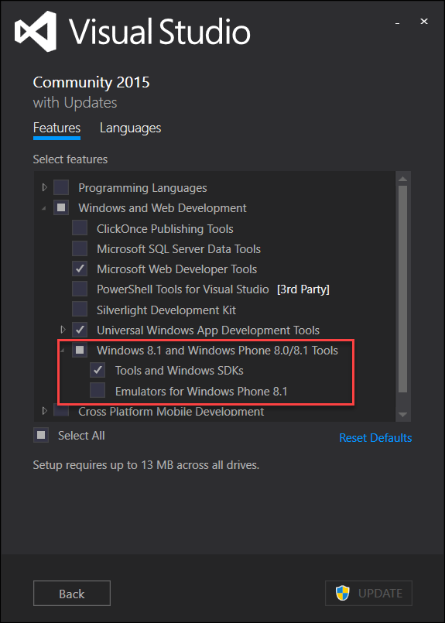
Windows 8.1 setup for Visual Studio 2015
Requires the Windows 8.1 tools module (C#/.NET Xamarin)
Requires the “Tools and Windows SDKs” module
Optional – Windows Phone 8.1 emulators

Slide 14
Tips ‘n’ tricks with Windows 8.1
Remember base Windows 8.0 is not supported on the store anymore, only Windows 8.1
Windows 8.1 builds have a limited lifespan but still supported on Windows 10 devices (thanks to the store up-conversion)
Physically testing is recommended, simulators / emulators will always have higher performance

Slide 15
Building for Windows 10 UWP
What’s required for Windows 10 development
Windows / Mobile / Xbox / IOT / Hololens

Slide 16
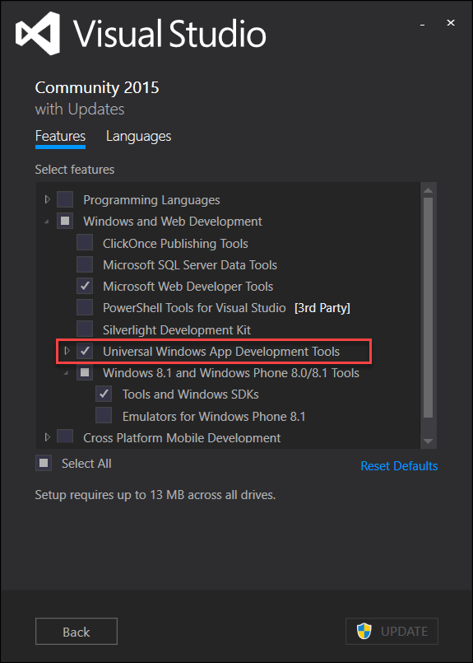
Windows 10 Visual Studio 2015 profile
Requires Universal Windows App Development Tools
Needs all SDK versions, which is the default
Windows 10 machine enabled for either “Sideloading” apps or “Development Mode” Settings -> Update & Security -> For Developers
Windows Store license required to ship (one time fee)

Slide 17
Tips ‘n’ tricks with Windows 10
“It just works” ™ :D
Keep an eye on the PR’s / Issues list. UWP received a lot of performance updates and tweaks for 3.6
As UWP is a “one size fits all” platform, plan for resolution / input patterns that your game will use. Remembering some platforms don’t have touch (I’m looking at you Xbox!)
MonoGame fully supports the new “Creators Dev program” as well as ID@Xbox
If you want to take your UWP game to native Xbox, talk to the MonoGame team for access to the Xbox branch (requires ID@Xbox agreement)

Slide 18
Other considerations

Slide 19
Other considerations building with MonoGame
Plan your content If targeting multiple platforms, try to use a single shared content project to reduce overhead Add additional “platform specific” content projects only when required
Market early It’s essential to build up good relations with each market store. Almost never too early to “get out in front”
Test often Some platforms will require more testing than others, plan to test deployment and not just gameplay. Use test tools where possibe.

Slide 20
Thanks for watching
Darkside of Monogame
Simon Jackson
Author and Microsoft MVP
@SimonDarksidej

